Slide 1

Note: The data and information in this document is reflective of a hypothetical situation and client. This document is to be used for KPMG Virtual Internship purposes only.
Sprocket Central Pty Ltd
Data analytics approach
Kabilan P - Junior Consultant

Slide 2
Note: The data and information in this document is reflective of a hypothetical situation and client. This document is to be used for KPMG Virtual Internship purposes only.
Agenda
Introduction
Data Exploration
Model Development
Interpretation

Slide 3
Note: The data and information in this document is reflective of a hypothetical situation and client. This document is to be used for KPMG Virtual Internship purposes only.
Introduction
The 3 datasets (Customer demographic, customer address and transactions) are analyzed to recommend which of the customers in New Customer List should be targeted to drive the most value for the organization.
Python and its libraries [Pandas (data manipulation), NumPy (numerical computing), Scikit Learn (for modelling)] are used to analyze and derive conclusions from the datasets.

Slide 4
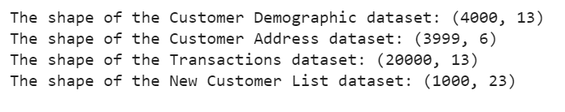
Note: The data and information in this document is reflective of a hypothetical situation and client. This document is to be used for KPMG Virtual Internship purposes only.
Data Exploration
The dimensions of the 4 datasets (including new customer list) were:
The 3 datasets (Customer demographic, customer address and transactions) are merged based on the Customer ID across these datasets.
Some columns are removed which doesn’t provide much value to the model such as : ['first_name’, 'last_name’, 'job_title’, 'deceased_indicator’, 'default’, 'address', 'postcode', 'state', 'country’]

Slide 5
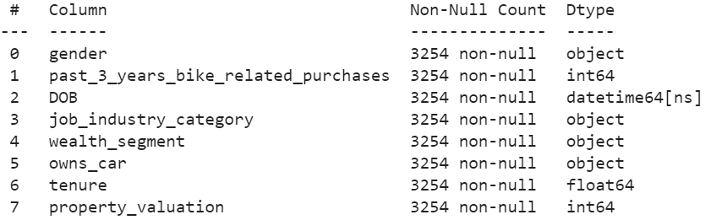
Note: The data and information in this document is reflective of a hypothetical situation and client. This document is to be used for KPMG Virtual Internship purposes only.
Data Exploration
There are many rows in the Data frame which contains missing values in certain features
The rows which contains missing values are removed from the Data Frame since during modelling its better to have accurate data than to impute (Data imputation is the substitution of estimated values for missing or inconsistent data items) values for these missing places.

Slide 6
Note: The data and information in this document is reflective of a hypothetical situation and client. This document is to be used for KPMG Virtual Internship purposes only.
Data Exploration
The following preprocessing is done on the columns of the Data Frame for the model to interpret it and for faster convergence.
Male is encoded as 1 and Female as 0.
DOB is converted to age and then encoded between 1 to 6 based on their age group.
If customer owns a car, encoded as 1; otherwise as 0
Job Industry Category and Wealth segment has categorical variables, so they are ordinally encoded using scikit-learn.preprocessing.OrdinalEncoder.
Tenure, Past 3 years bike related purchases and Property valuation are scaled to between [0,1] for faster convergence during modelling.
These processed data is now converted to NumPy format from data frame for modelling.
The data frame has 2853 customer details after removing customer ids whose details were missing

Slide 7
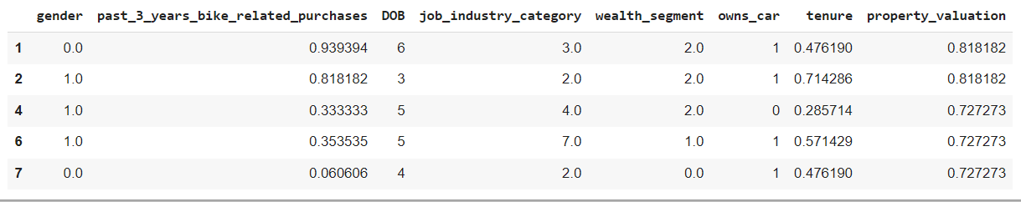
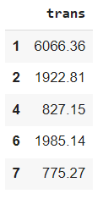
Note: The data and information in this document is reflective of a hypothetical situation and client. This document is to be used for KPMG Virtual Internship purposes only.
Model Development
Since the dataset is a relatively small dataset (2853 samples) for a machine learning model, a type of gradient boosting algorithm- XGBoost is used. 2850 samples are used for training the model with each customer’s net transactions as the label, and 3 samples for testing the results of the trained model.

Slide 8
Note: The data and information in this document is reflective of a hypothetical situation and client. This document is to be used for KPMG Virtual Internship purposes only.
Model Development
The trained model is used to predict the label of the test dataset and is compared with the actual transactions of those customers.
The results are as follows:
Predicted Transactions: Actual Transactions:

Slide 9
Note: The data and information in this document is reflective of a hypothetical situation and client. This document is to be used for KPMG Virtual Internship purposes only.
Interpretation
Customers whose values are removed from the new customer list and the remaining customer’s (818 after removing) transaction predictions are made by testing their features with the trained XGBoost model and are ranked based on their ‘Transaction’ value.
Based on this rank the new customers can be targeted, since they are predicted based on the trained XGBoost model to drive the most value for the organization.
The link for the code in Google Colab and GitHub versions are added in the Appendix that follows.

Slide 10
Note: The data and information in this document is reflective of a hypothetical situation and client. This document is to be used for KPMG Virtual Internship purposes only.
Appendix

Slide 11
Note: The data and information in this document is reflective of a hypothetical situation and client. This document is to be used for KPMG Virtual Internship purposes only.
Appendix
The code of the analysis and the rank list can be found here: https://colab.research.google.com/drive/1UHzHj7kZE06ray99BVa1FGEru9GErqLs?authuser=3#scrollTo=nMpQnfk6RWQB
The GitHub version of the code can be found here: https://github.com/kabilan942/Hugging-Face/blob/main/KPMG/KPMG_Task_2.ipynb

